Slide 1
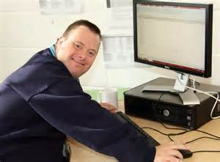
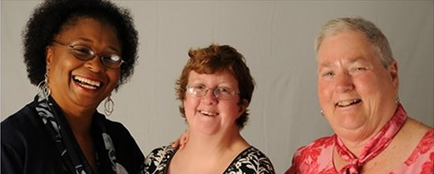
Past, Present, & Future of the Self-Advocacy Movement
Told by Tia Nelis
Renae Alvarez, MPH
Support
A key aspect of self-advocacy is self-determination—people self-directing their lives in positive ways.
As other facets of people’s lives are properly established and people are gaining access to meaningful employment, self-advocates can
now be supported to move up in the
hierarchal structure and take on
leadership roles.
Individual support– Support the person with a disability by asking them what kind of support they need
Organizational support– System or infrastructure in place to create a culture of inclusion
Clearly outline the job responsibilities
Understand what supports the person will need day to day
Provide employee training if the person feels less comfortable about a particular task
Build an trusting environment to explore, learn, and make mistakes without consequences, so they feel supported in their attempts to grow
Go over responsibilities if out-of-office work is required (e.g., times and dates, costs of traveling, support for travel)
Provide a clear line of communication so the person with a disability feels comfortable going to someone if they have questions or concerns—HR flexibility
Future
Directions
Supporting self-advocates being leaders cannot be done alone.
As national initiatives provide employment for people with disabilities, a sustainable infrastructure needs to be created to support people with disabilities, organizations, and support staff.
New initiative: MCHB, AUCD, LENDs/UCEDDs have established a workgroup to promote the inclusion of people with disabilities in LEND programs.
Role of person with a disability
Before taking the job, understanding the pros and cons, especially if it’s in a new state
Communicate about what
supports they need
Current Landscape
Recommendations:
Build relationships with self-advocate organizations and self-advocates
Fund initiatives to create an infrastructure for self-advocate leaders
Provide more opportunities to advance advocacy skills and leadership potential
Include training and technical assistance for allies and support staff in how to support people with IDD in their leadership roles
Establish network of peer support—emphasis on career building and finding career path
Talk about importance of work-life balance and engaging in things outside of self-advocacy movement
Create a pipeline for youth with disabilities who show leadership potential
Evaluate the process with self-advocates
Be more inclusive of other audiences (LGBTQ, other disability groups)
People with disabilities have learned self-advocacy skills and used them in various areas of their lives where they have experienced discrimination because of their disability (workplace, school, housing, transportation).
Self-advocates who have been a part of this movement for over a decade are seeking more opportunities to expand their reach and to grow as leaders.
The growing number of self-advocacy organizations has built a network of organizational supports for people with IDD. A few examples:
History
The self-advocacy movement in the US is a human rights movement of and by people with intellectual and developmental disabilities (IDD).
Self-advocacy summits for advocates, UCEDDs, P&As, and DD Councils to work together around self-advocacy in their state
University Centers of Excellence on Developmental Disabilities (UCEDDs) formed Consumer Advisory Councils
People with disabilities have moved into the competing workforce (starting own businesses)
Annual policy seminar teaches about current issues affecting the lives of people with IDD and advocacy skills
Grants are provided for self-advocacy organizations
National Gateway to Self-Determination
National Youth Leadership Network
National Disability Right’s Network
Mid-1970s: Self-advocacy organizations began in some states.
Sept 1990: 1st national gathering of self-advocates, Estes Park, CO.
2 representatives from each region elected to be a part of national steering committee
April 1994: SABE board created bi-laws in Knoxville, TN because SABE wanted to learn from and meet where other civil rights leaders met.
Self-advocacy involves people with disabilities working together to take charge of their lives, fight discrimination, and advocate for justice.
References can be provided upon request

